Slide 1
Explainable analytics: understanding causes, correcting errors, and achieving increasingly perfect accuracy from the nature of distinguishable patterns
Presenters: M. Kirdin, K. Ostudina
Authors: Hao-Ting Pai, Chung-Chian Hsu
Published in: Scientific Reports volume 12 (2022)

Slide 2
Outline
Problem Statement
Methods
Experiments & Results
Conclusion
References

Slide 3
Problem Statement
The article addresses the challenge of making inaccurate classification and prediction errors explainable. These errors are caused by issues like faulty or inconsistent data, mismatches between data types and analytical methods, as well as the increasing complexity of large datasets, commonly referred to as the curse of dimensionality.

Slide 4
Methods

Slide 5
Methods
The authors propose Transparent Classification method.
Requirements:
An algorithm that can visualize causes of prediction errors in a network and therefore make them traceable and correctable.
As is:
It uses pure positive and negative patterns to classify data

Slide 6
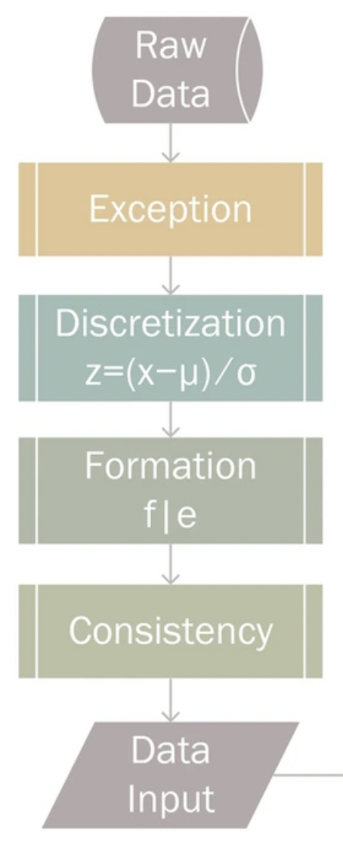
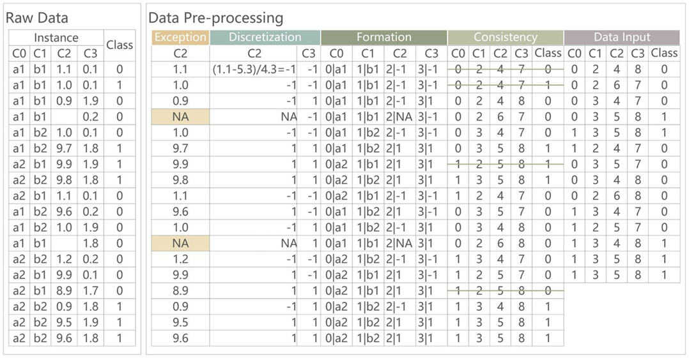
Data Preprocessing

Slide 7
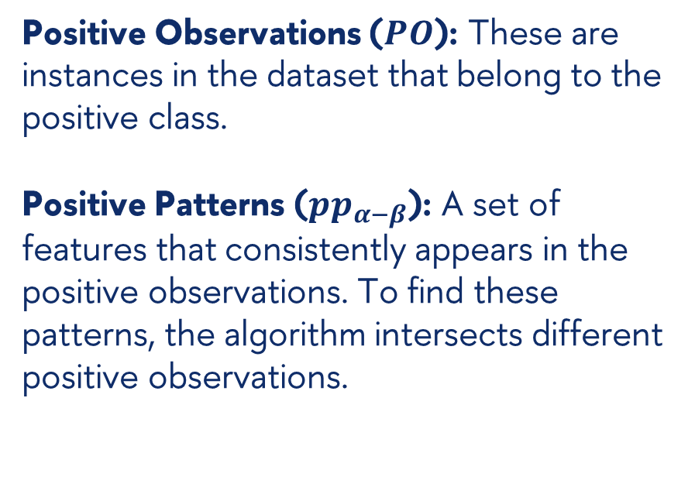
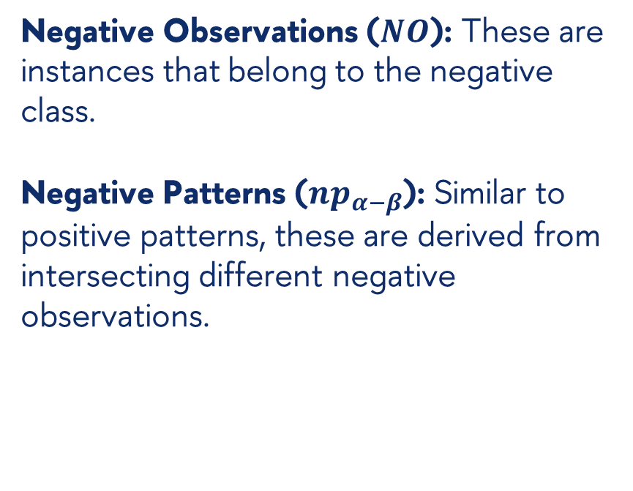
Identifying Distinguishable Patterns
Positive Observations ($PO$): These are instances in the dataset that belong to the positive class.
Positive Patterns ($pp_{α−β}$): A set of features that consistently appears in the positive observations. To find these patterns, the algorithm intersects different positive observations.
Negative Observations ($NO$): These are instances that belong to the negative class.
Negative Patterns ($np_{α−β}$): Similar to positive patterns, these are derived from intersecting different negative observations.

Slide 8
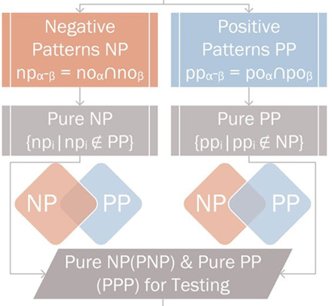
Identifying Distinguishable Patterns
A Pure Positive Pattern (PPP) is a positive pattern that does not appear in any negative observation.
A Pure Negative Pattern (PNP) is a negative pattern that does not appear in any positive observation.

Slide 9
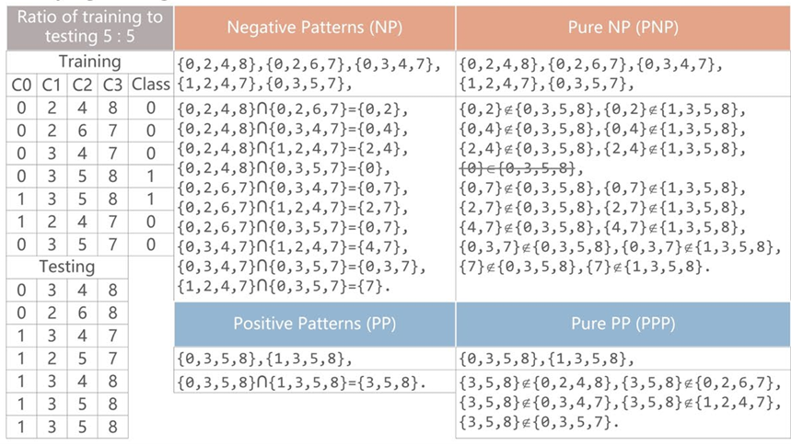
Identifying Distinguishable Patterns

Slide 10
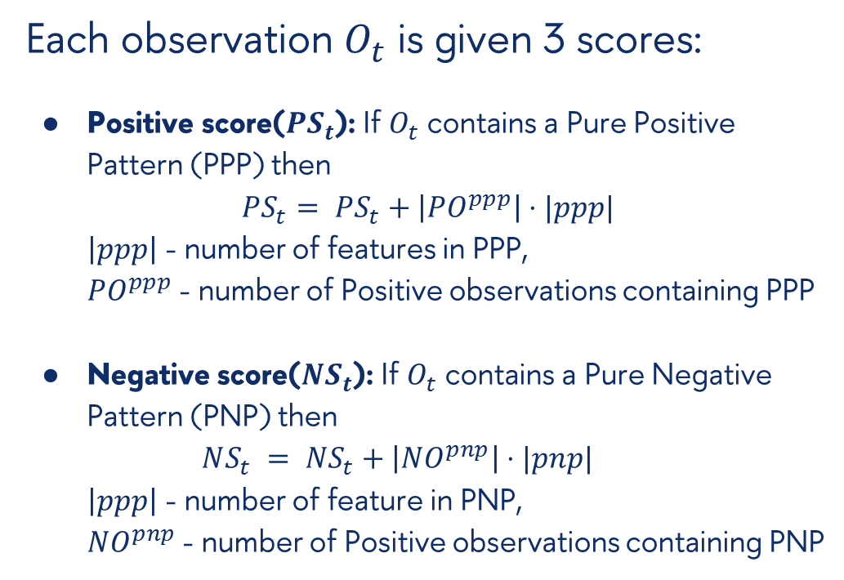
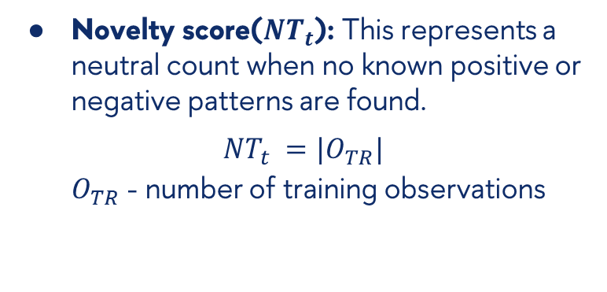
Establishing the Causes
Each observation $O_{t}$ is given 3 scores:
Positive score($PS_{t}$): If $O_{t}$ contains a Pure Positive Pattern (PPP) then
$$PS_{t}= PS_{t}+\left|PO^{ppp}\right|⋅|ppp|$$
$\left|ppp\right|$ - number of features in PPP,
$PO^{ppp}$ - number of Positive observations containing PPP
Negative score($NS_{t}$): If $O_{t}$ contains a Pure Negative Pattern (PNP) then
$$NS_{t} = NS_{t}+\left|NO^{pnp}\right|⋅|pnp|$$
$\left|ppp\right|$ - number of feature in PNP,
$NO^{pnp}$ - number of Positive observations containing PNP
Novelty score($NT_{t}$): This represents a neutral count when no known positive or negative patterns are found.
$$NT_{t} =|O_{TR}|$$
$O_{TR}$ - number of training observations

Slide 11
Understanding Results of Analytics
The authors evaluate the performance of the TC method by three metrics:
Precision. Measures the accuracy of positive predictions.
Recall. Measures the ability to find all relevant instances (true positives).
Area Under Curve (AUC). Assesses the model's ability to discriminate between positive and negative classes.
AUC value | Discrimination
< 0.5 | no discrimination
0.5 to 0.7 | acceptable
0.7 to 0.9 | excellent
> 0.9 | outstanding

Slide 12
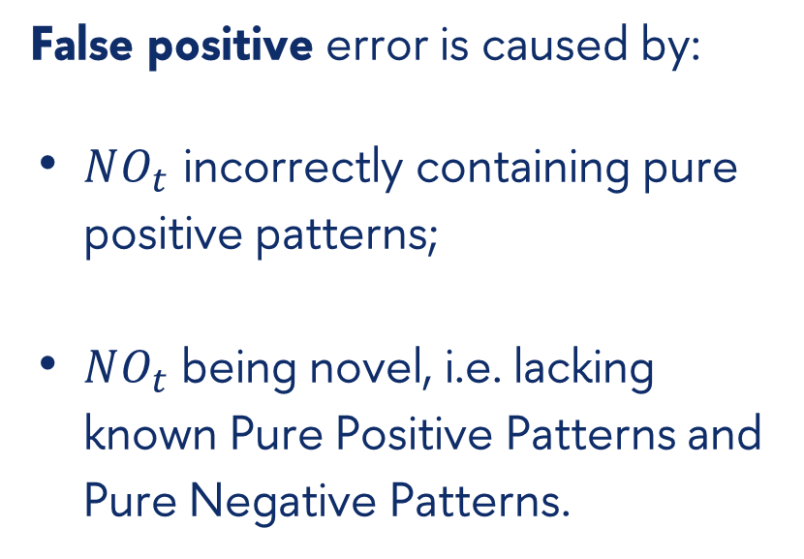
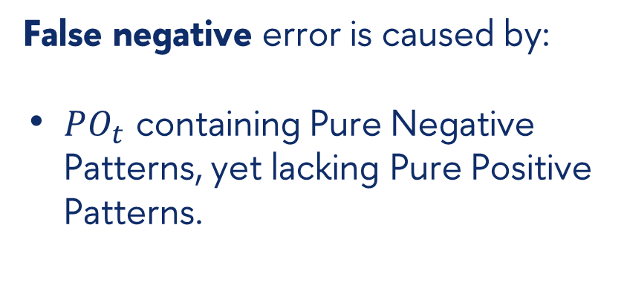
Understanding Results of Analytics
False positive error is caused by:
$NO_{t}$ incorrectly containing pure positive patterns;
$NO_{t}$ being novel, i.e. lacking known Pure Positive Patterns and Pure Negative Patterns.
False negative error is caused by:
$PO_{t}$ containing Pure Negative Patterns, yet lacking Pure Positive Patterns.

Slide 13
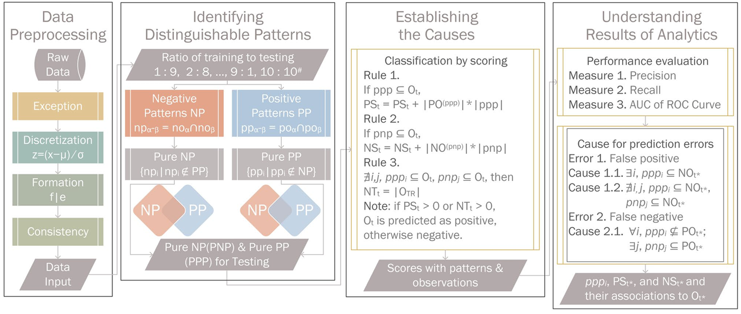
TC method step-by-step

Slide 14
Experiments & Results

Slide 15
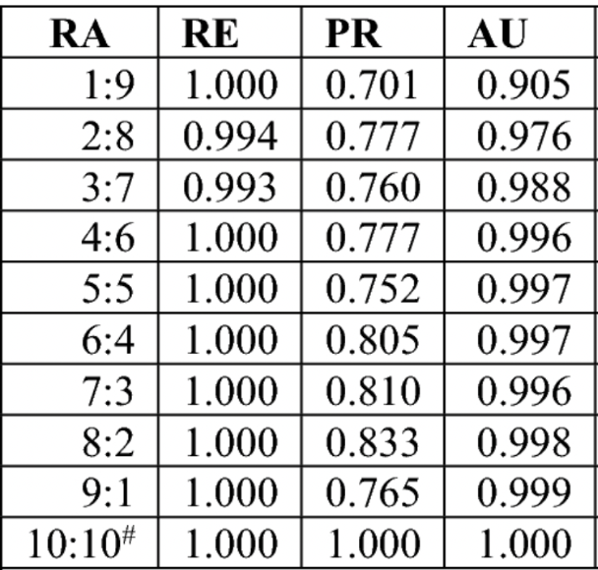
Performance on BCWO dataset
No. features: 9 + 1 target class label
No. instances: 699
RA: Ratios of training to testing; RE: Recall; PR: Precision; AU: AUC of ROC Curve.

Slide 16
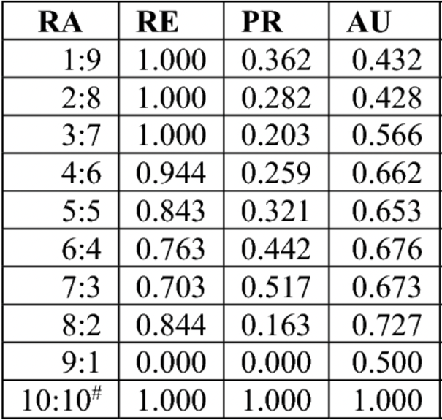
Performance on CMC dataset
No. features: 9 + 1 target class label
No. instances: 1473
RA: Ratios of training to testing; RE: Recall; PR: Precision; AU: AUC of ROC Curve.

Slide 17
Results
The TC method performed well on the Breast Cancer Wisconsin (BCWO) dataset, handling faulty labels and imbalanced data effectively.
On the Contraceptive Method Choice (CMC) dataset, results improved with larger training to testing ratios, but the inherent inconsistency in the data remained a challenge.

Slide 18
Conclusion
The Transparent Classification method shows promise in both machine learning and data analysis, particularly in uncovering patterns in complex datasets and detecting labeling errors.

Slide 19

References
Thanks!
Pai, HT., Hsu, CC. Explainable analytics: understanding causes, correcting errors, and achieving increasingly perfect accuracy from the nature of distinguishable patterns. Sci Rep 12, 18368 (2022). https://doi.org/10.1038/s41598-022-19650-2
Gabriela Alexe, Peter L. Hammer. Spanned patterns for the logical analysis of data. Discrete Applied Mathematics, Volume 154, Issue 7, 2006, pp. 1039-1049, ISSN 0166-218X, https://doi.org/10.1016/j.dam.2005.03.031

